Slide 1
WRAPPING UP & GOING BEYOND THE BASICS
MPA 630: Data Science for Public Management
December 13, 2018
Fill out your reading report on Learning Suite

Slide 2
PLAN FOR TODAY
What the heck did we just learn?
Going beyond the basics
Ethics of data
Curiosity

Slide 3
WHAT THE HECK DID WE JUST LEARN?

Slide 5
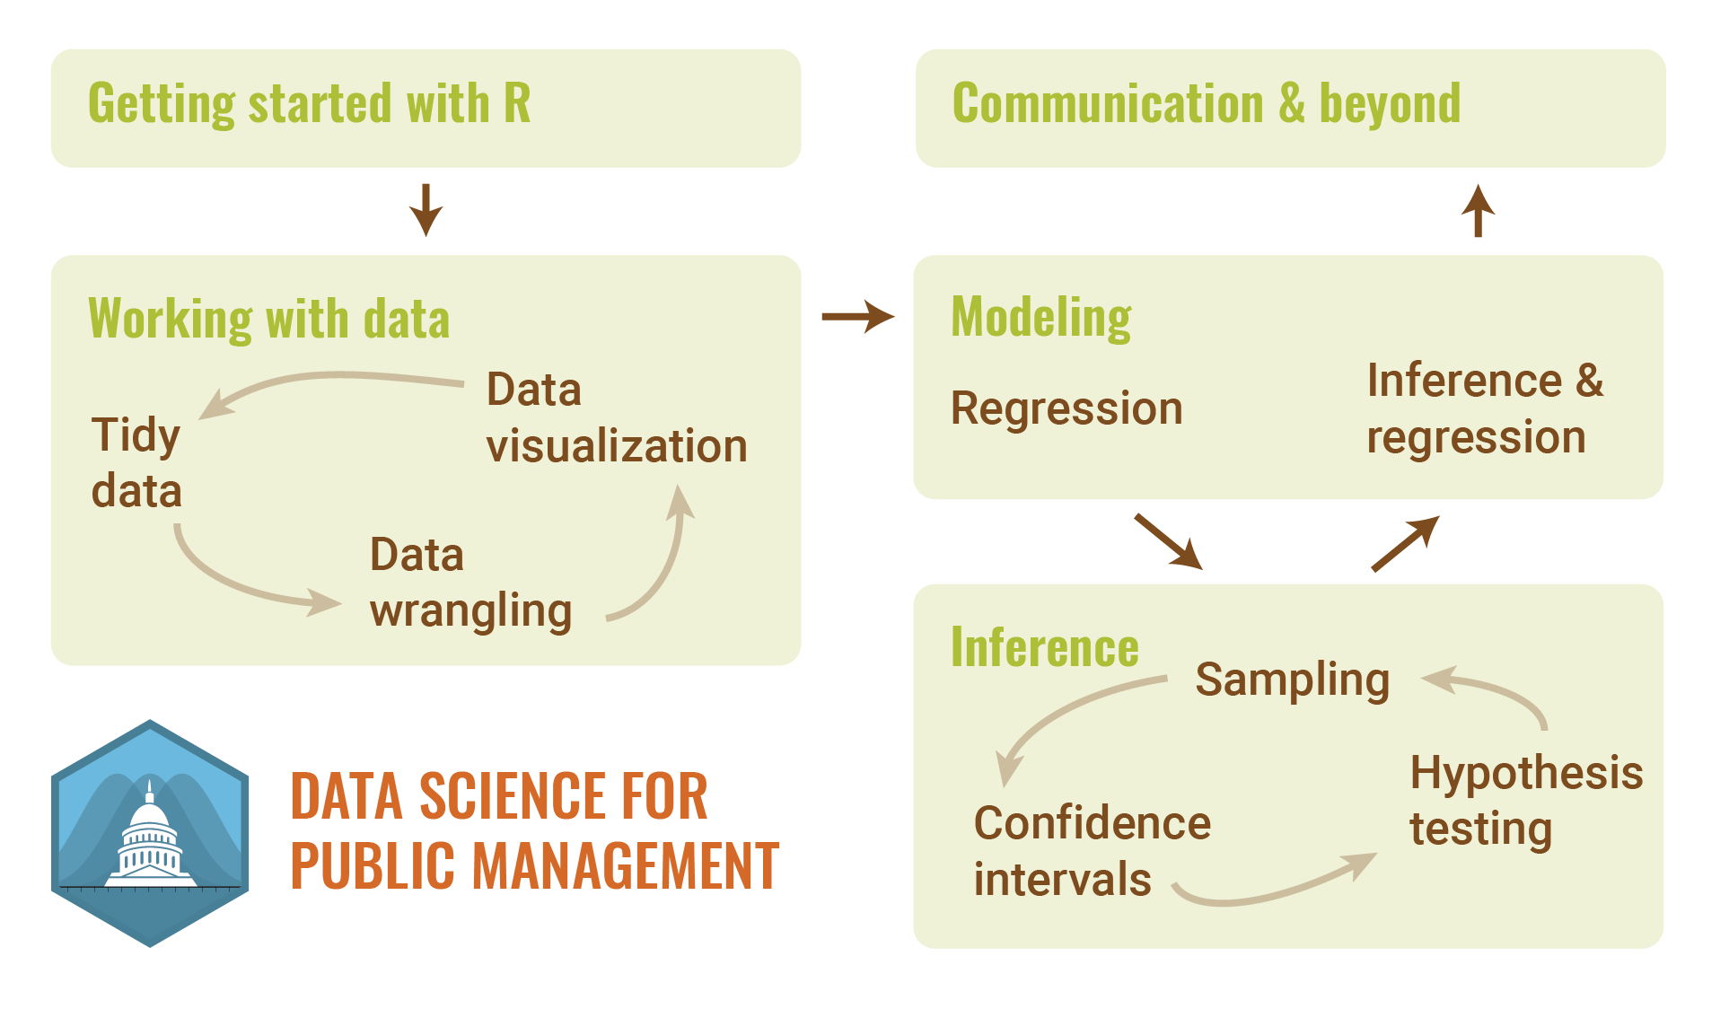

Slide 6
WHAT IS “DATA SCIENCE”?
Turning raw data into understanding, insight, and knowledge
Collect
Analyze
Communicate
Notes:
Scientism
https://twitter.com/neiltyson/status/345551599382446081

Slide 7
GOING BEYOND THE BASICS

Slide 8
FLAVORS OF REGRESSION
Linear regression (OLS)
Y is numeric
Logistic regression
Y is 2 categories
Ordered logistic regression
Y is 3+ categories

Slide 9
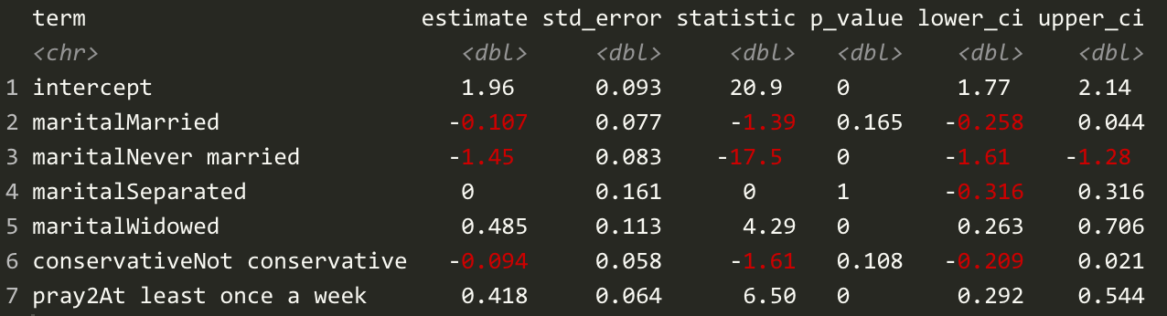
LINEAR REGRESSION
For every 1 unit increase in X, there’s a β change in Y

Slide 10
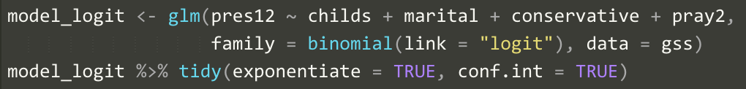
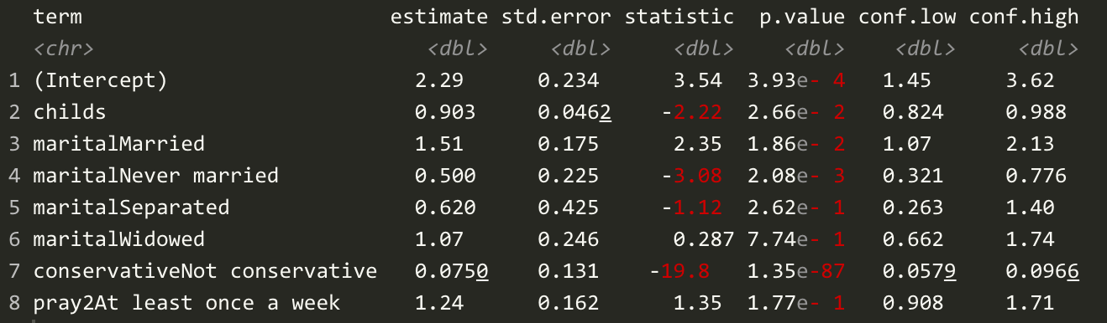
LOGISTIC REGRESSION
For every 1 unit increase in X, there’s a β% change in the probability of Y happening
Odds ratios
_{Centered around 1}

Slide 11
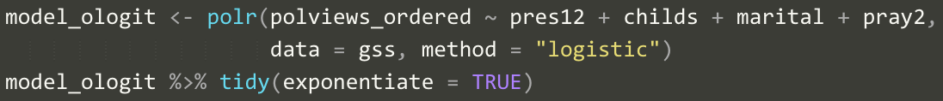
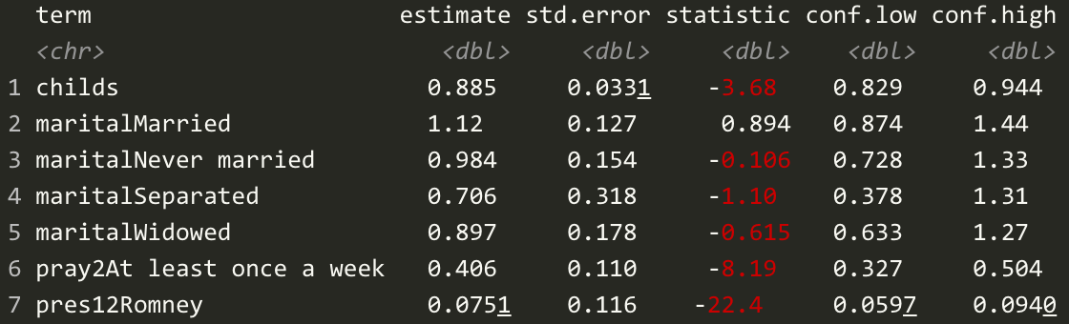
ORDERED LOGISTIC REGRESSION
For every 1 unit increase in X, there’s a β% change in the probability of moving to next level of Y
Odds ratios
_{Centered around 1}

Slide 12
MORE WITH R
Geography
Text
Interactivity
Dashboards
Sharing R Markdown

Slide 13
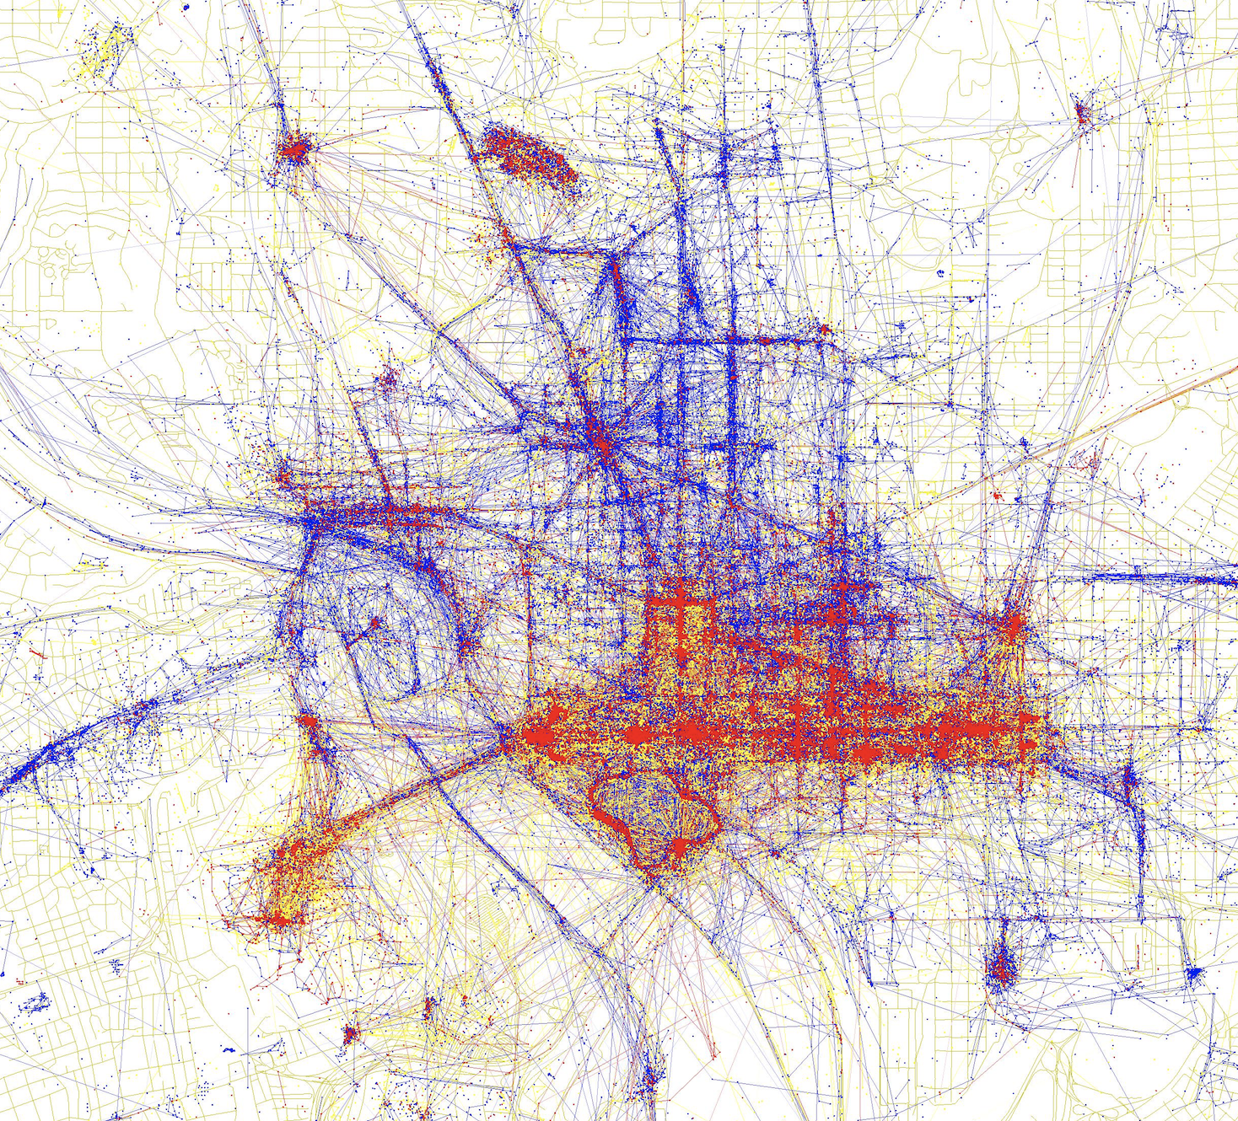

Slide 14
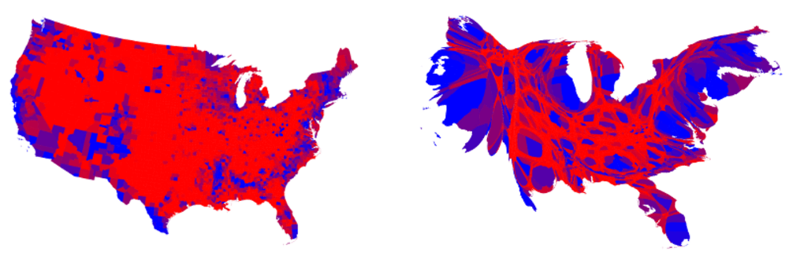
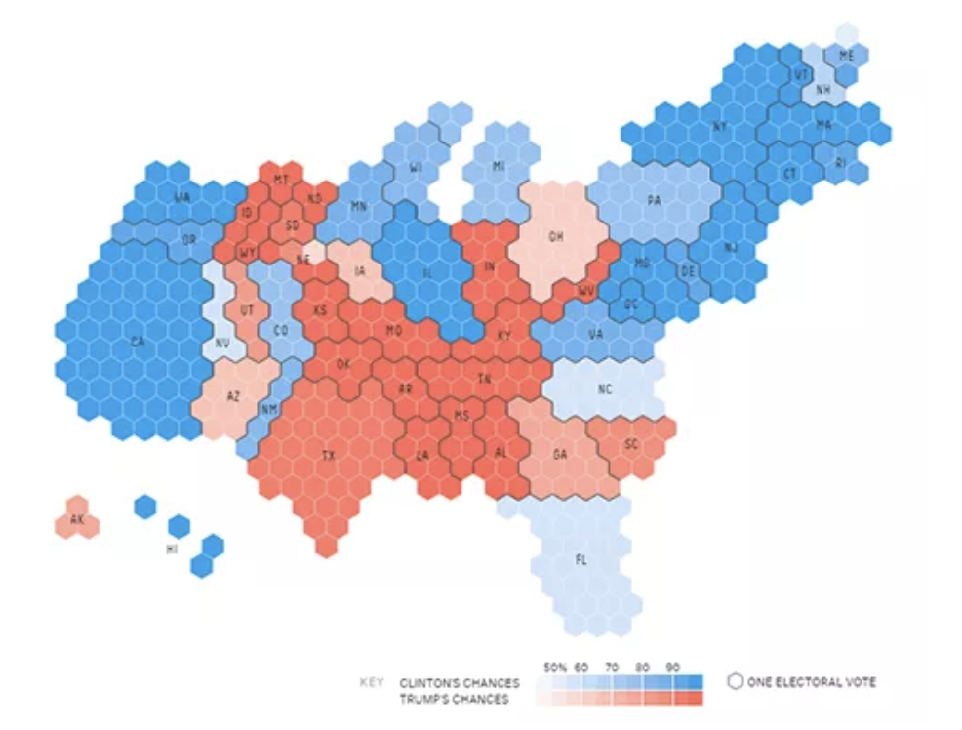

Slide 15
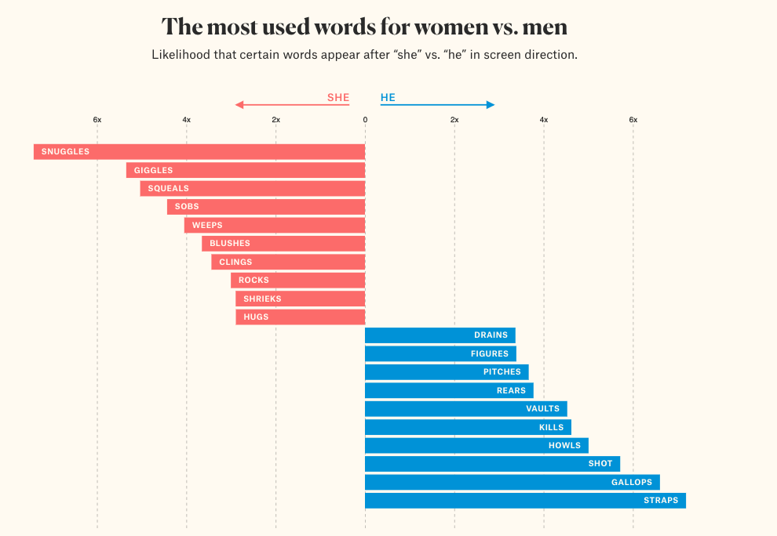

Slide 16
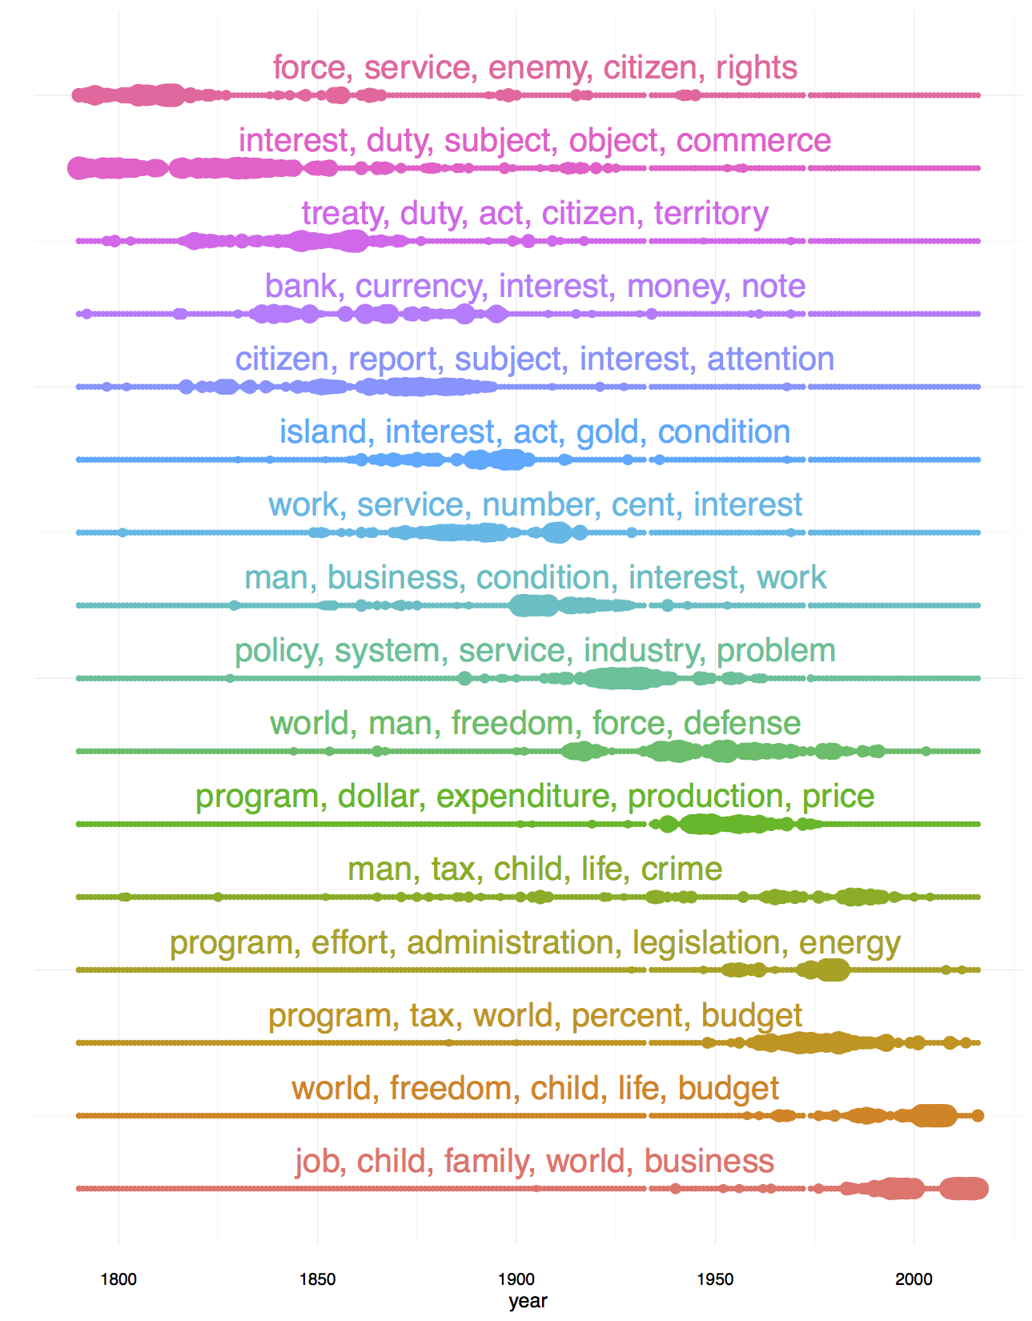

Slide 18
ETHICS OF DATA

Slide 19
POSSIBLE PITFALLS
Manipulation
Don’t coerce people
Don’t make critical decisions on data alone
Bias
There’s no such thing as an objective model

Slide 20
Manipulation

Slide 21
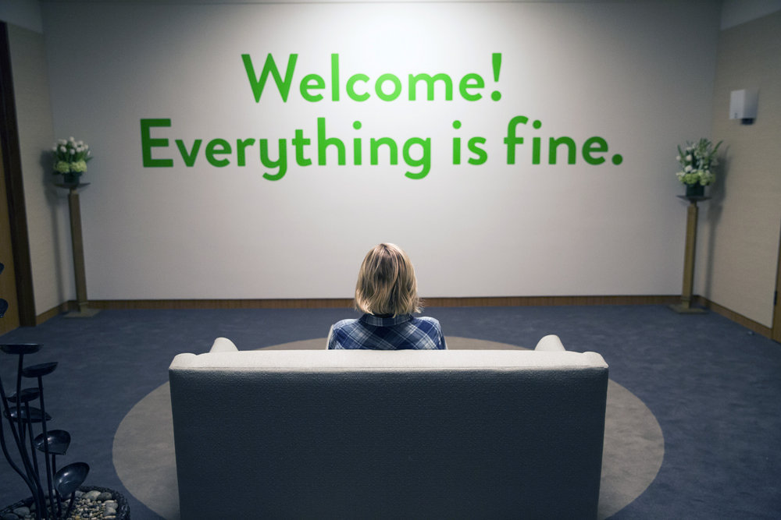

Slide 22
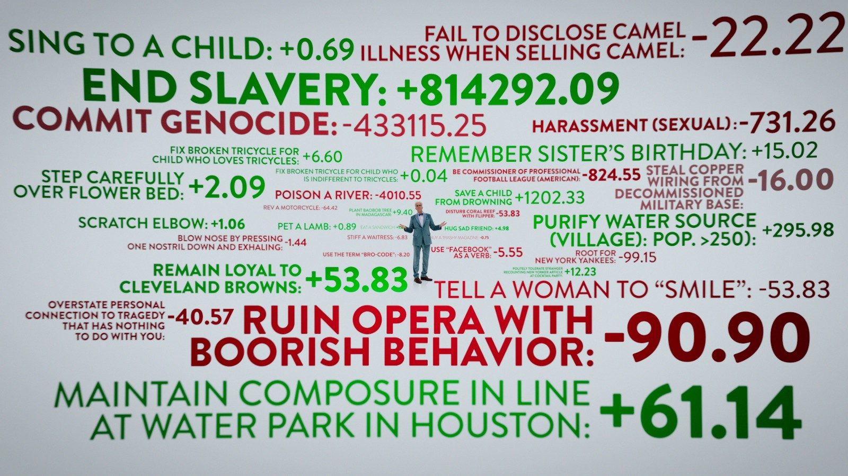

Slide 23
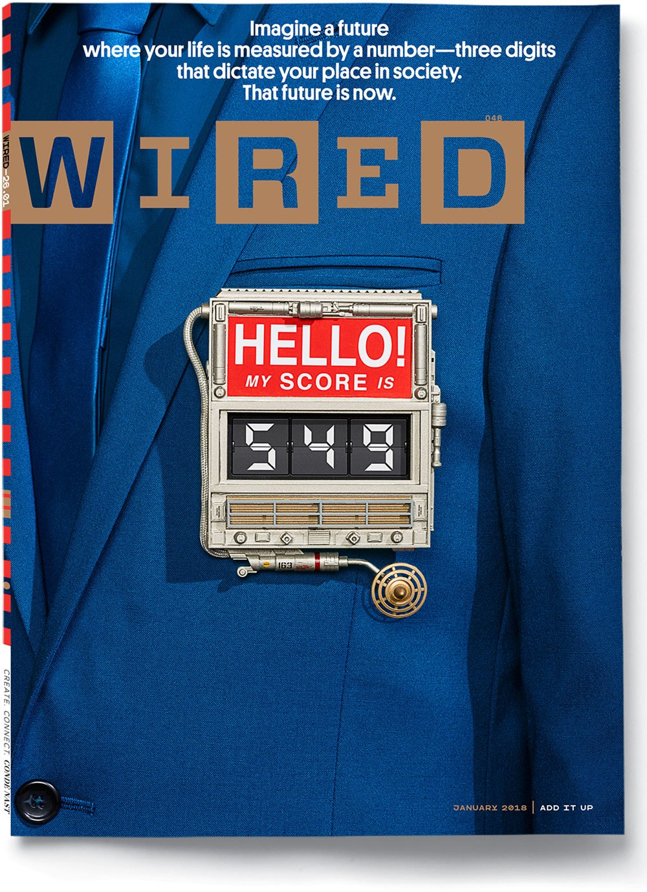
Notes:
https://www.wired.com/story/age-of-social-credit/

Slide 24
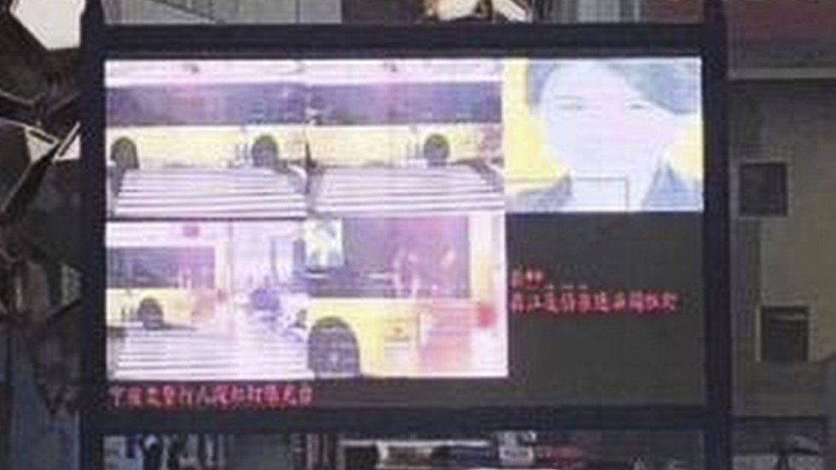
Notes:
https://boingboing.net/2018/11/26/just-dont-have-a-face.html

Slide 25
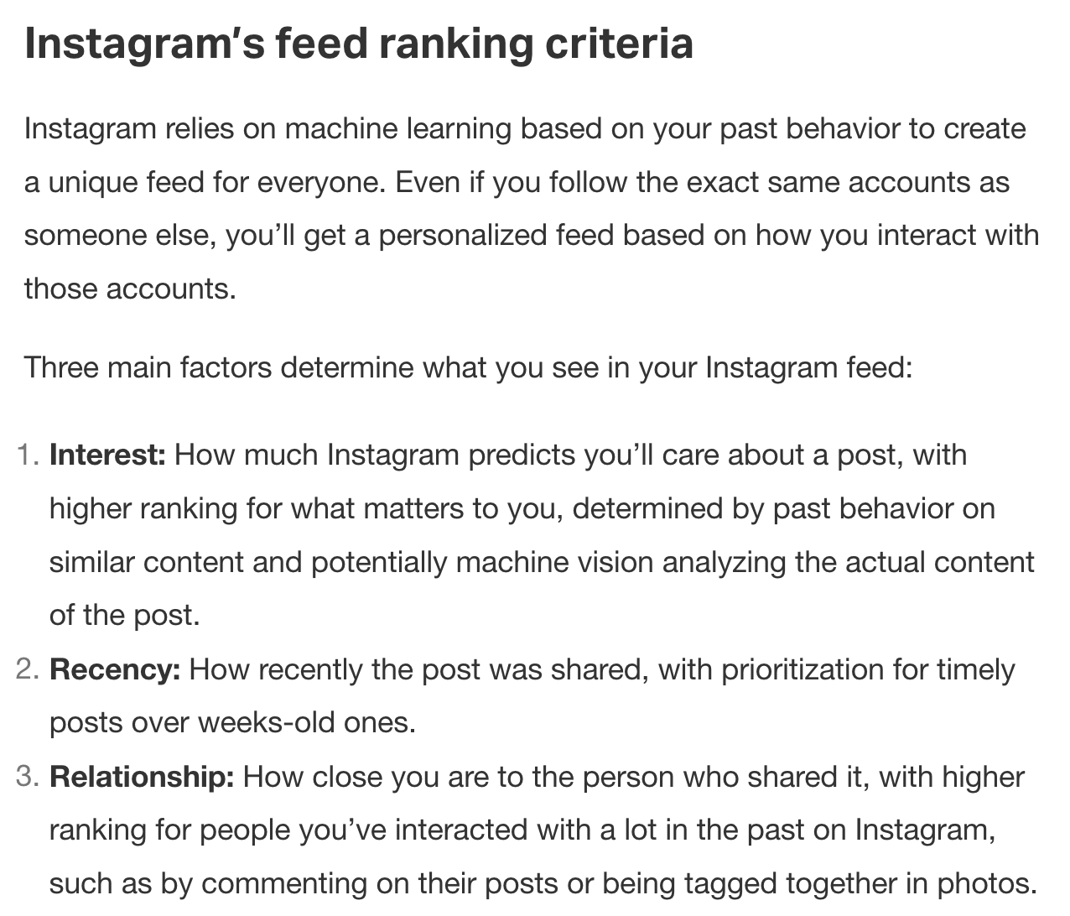
Notes:
https://techcrunch.com/2018/06/01/how-instagram-feed-works/

Slide 26


Slide 27
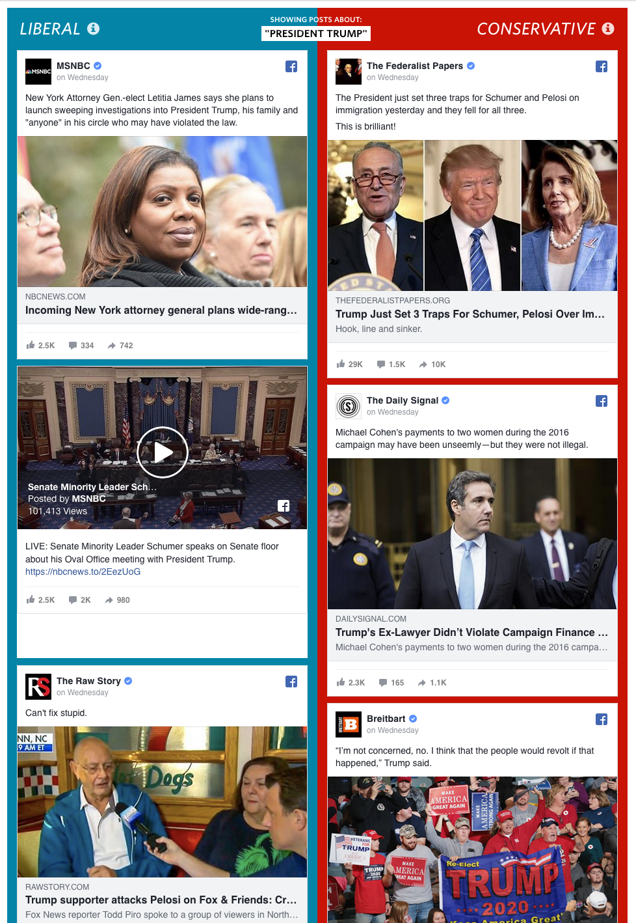
Notes:
http://graphics.wsj.com/blue-feed-red-feed/#/president-trump

Slide 28

Notes:
https://www.wired.com/2014/08/i-liked-everything-i-saw-on-facebook-for-two-days-heres-what-it-did-to-me/

Slide 29
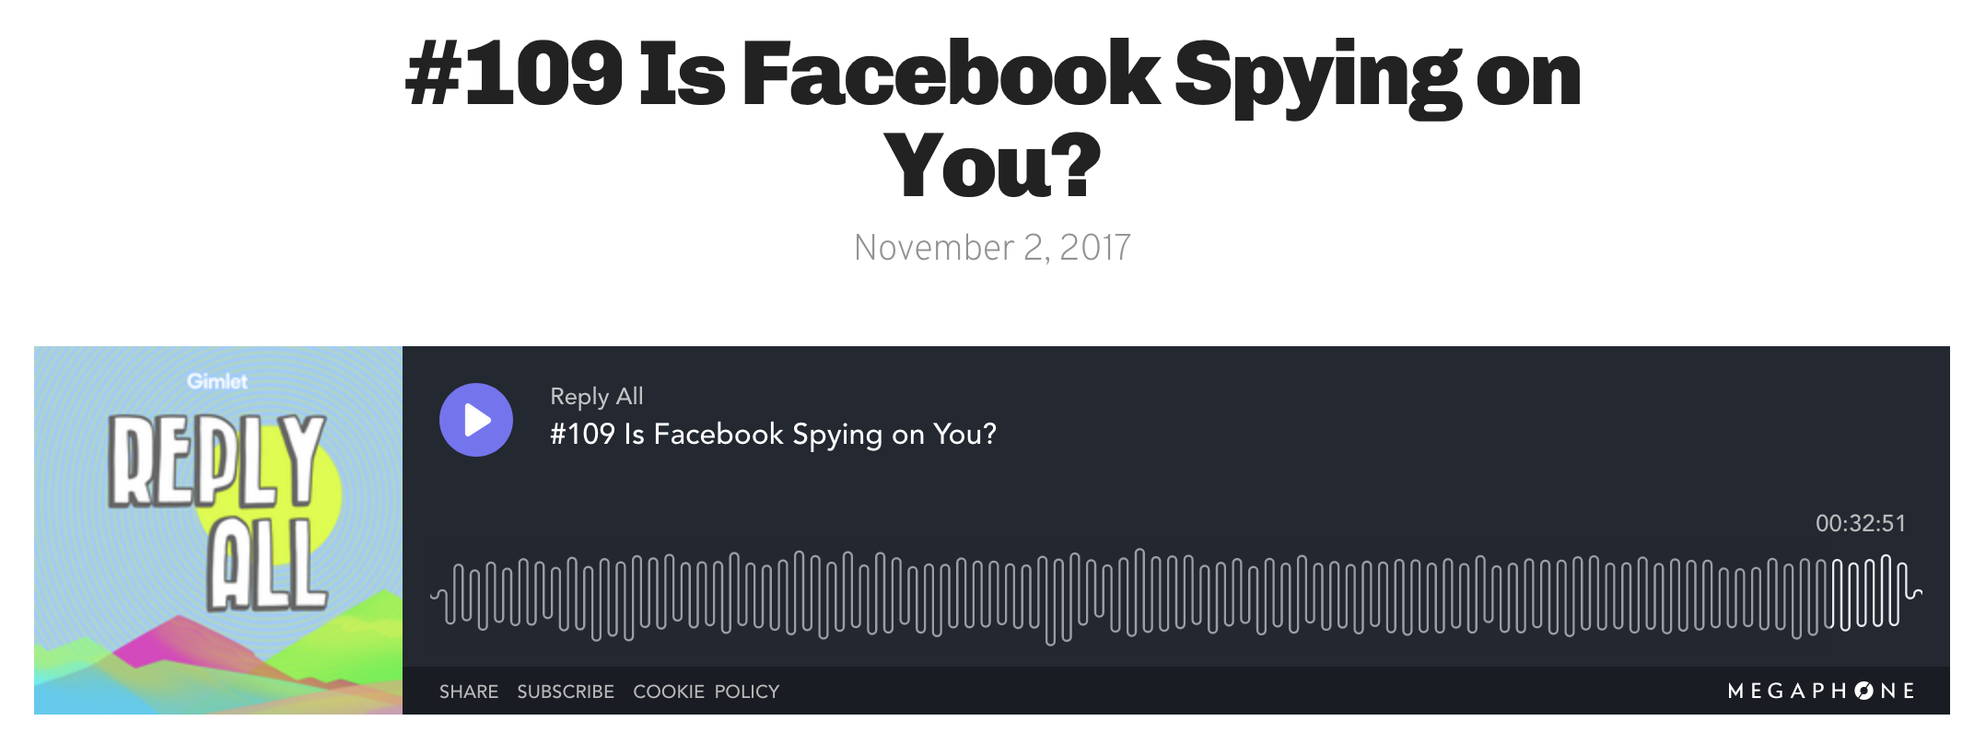
Notes:
https://www.gimletmedia.com/reply-all/109-facebook-spying

Slide 30
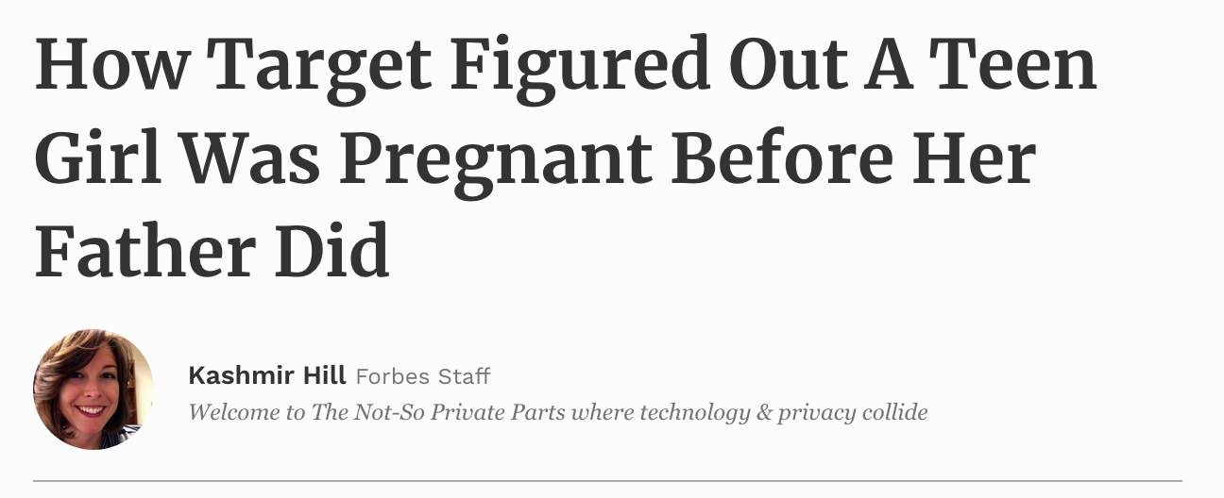
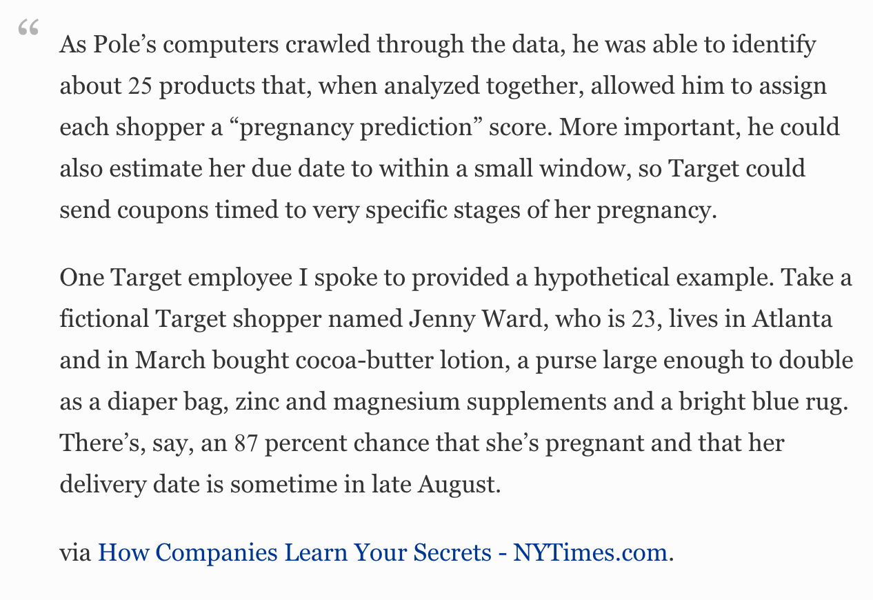
Notes:
https://www.forbes.com/sites/kashmirhill/2012/02/16/how-target-figured-out-a-teen-girl-was-pregnant-before-her-father-did/#74dc8acf6668

Slide 31
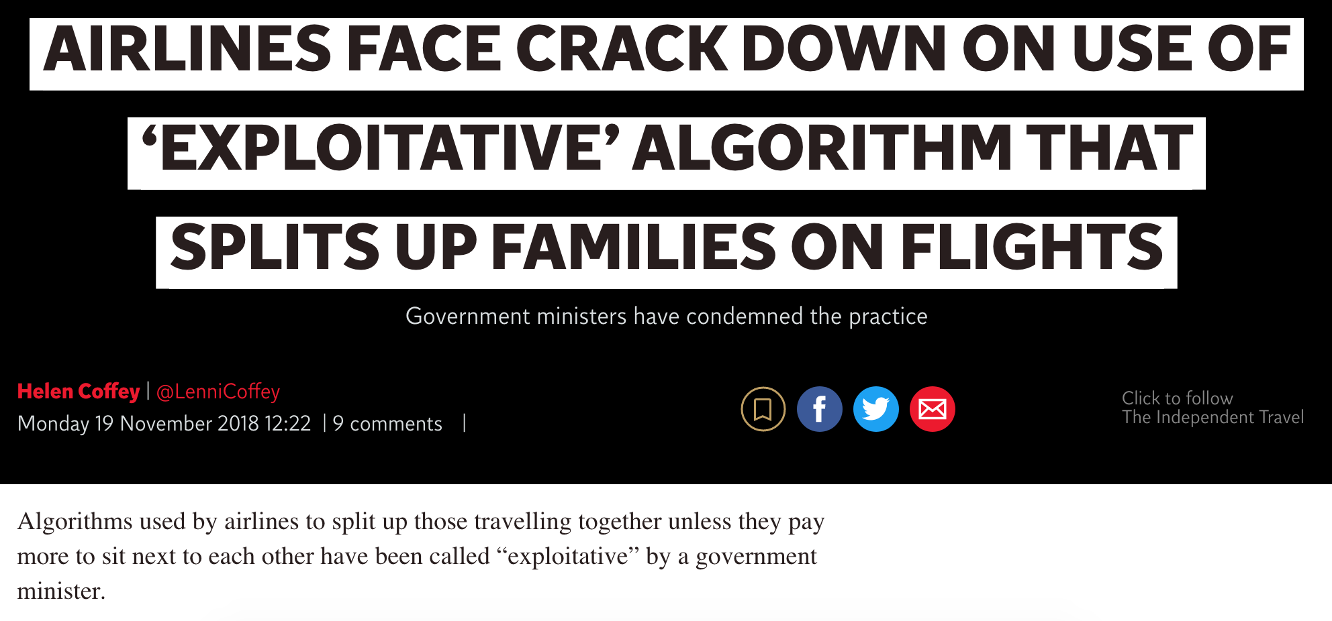
Notes:
https://www.independent.co.uk/travel/news-and-advice/airline-flights-pay-extra-to-sit-together-split-up-family-algorithm-minister-a8640771.html

Slide 32
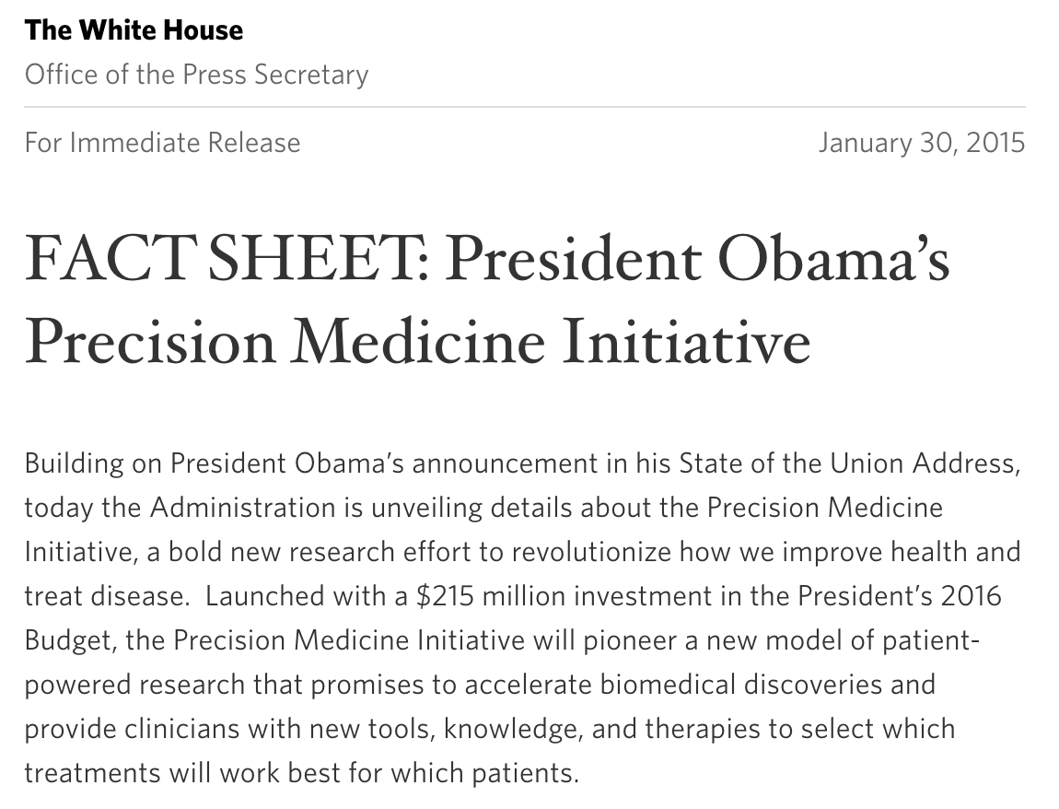

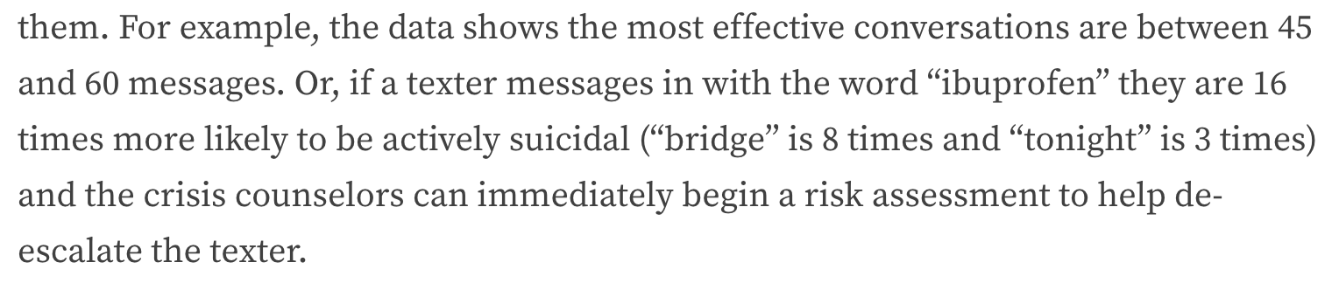
IT’S NOT ALL DYSTOPIAN

Slide 33
What makes the social score and the crisis score ethically different?
Or are they the same thing?

Slide 34
AVOID MANIPULATION
Think about people
Think about autonomy
You shall not live on data alone

Slide 35
Bias

Slide 36
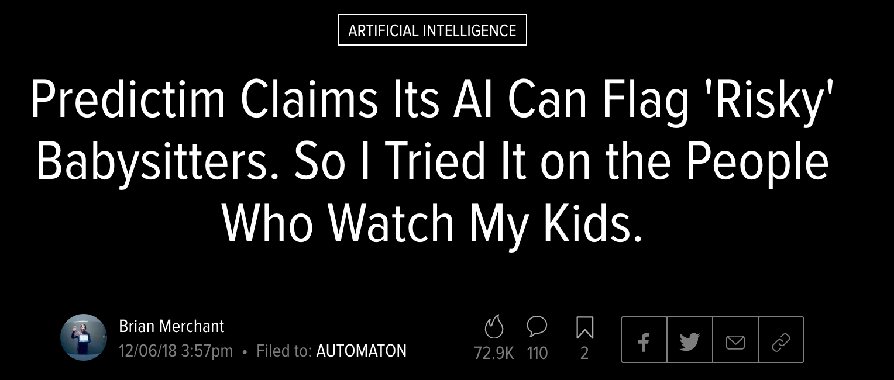
Notes:
https://gizmodo.com/predictim-claims-its-ai-can-flag-risky-babysitters-so-1830913997

Slide 37
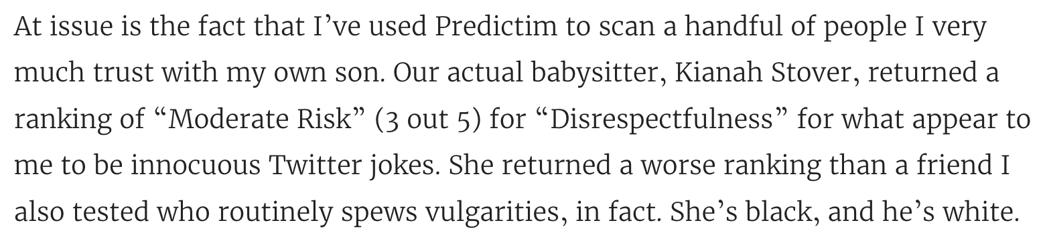
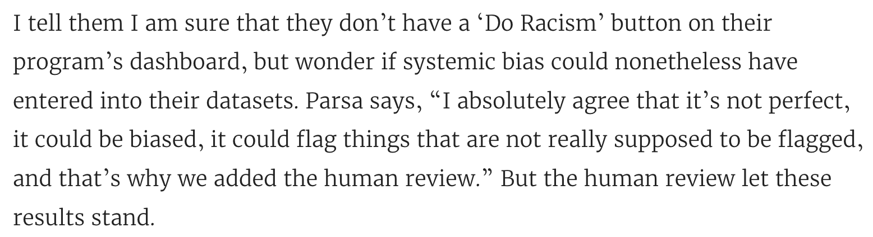

Slide 38
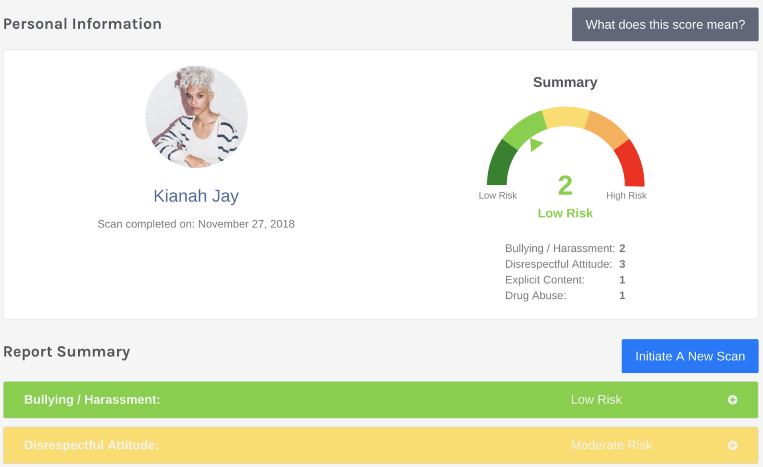

Slide 39
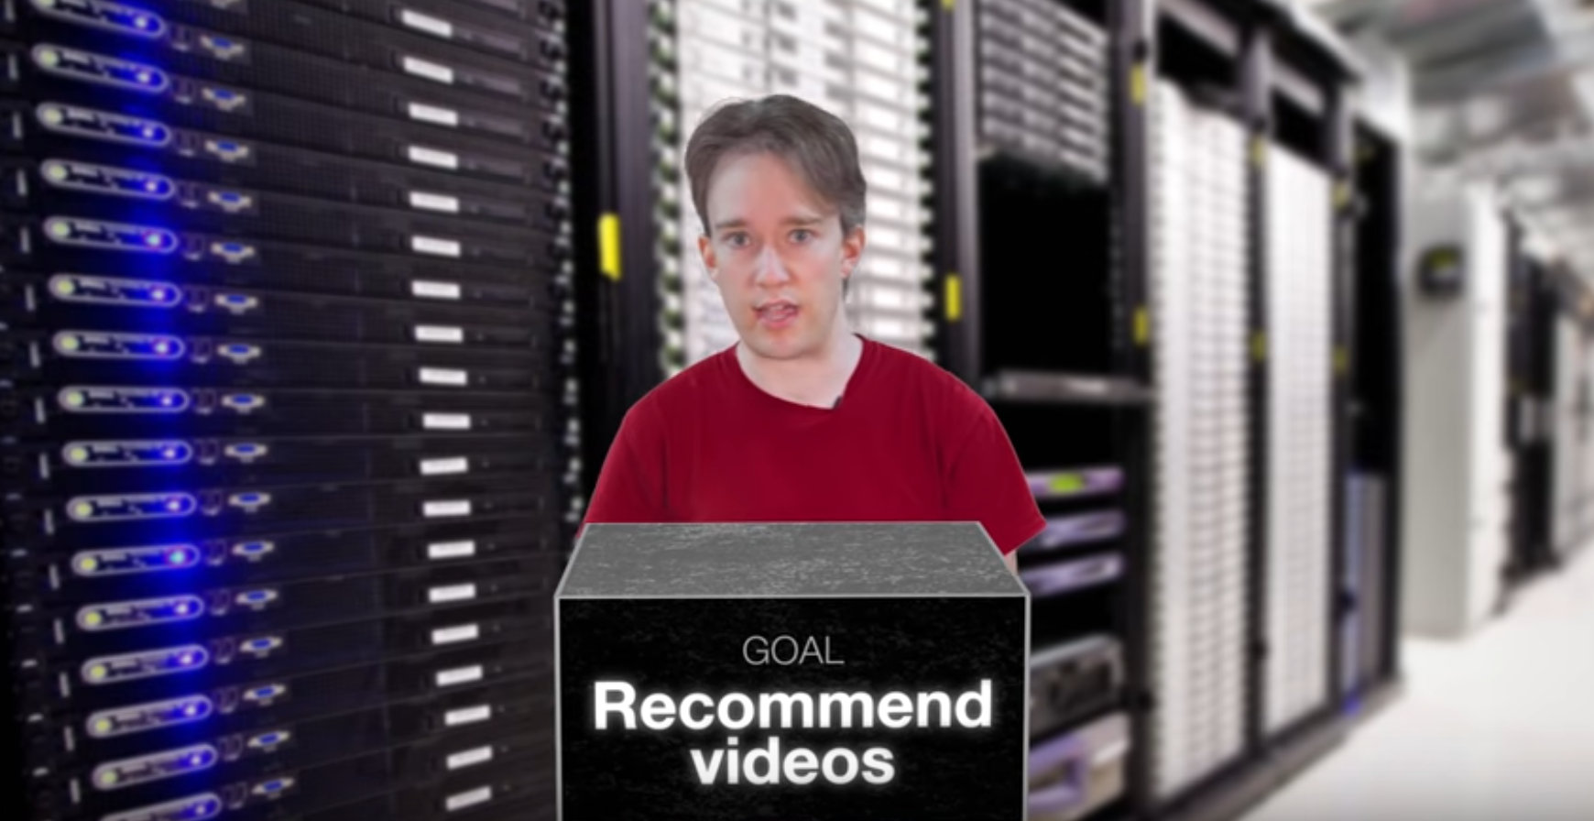
https://www.youtube.com/watch?v=BSpAWkQLlgM
Notes:
https://www.youtube.com/watch?v=BSpAWkQLlgM

Slide 40

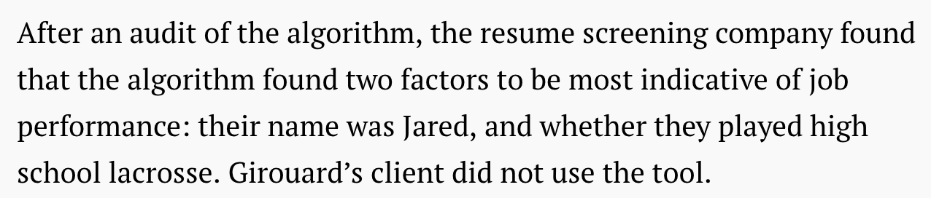
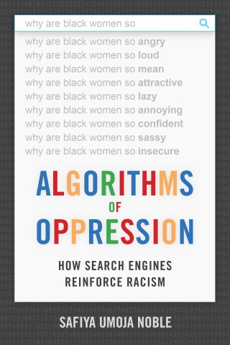
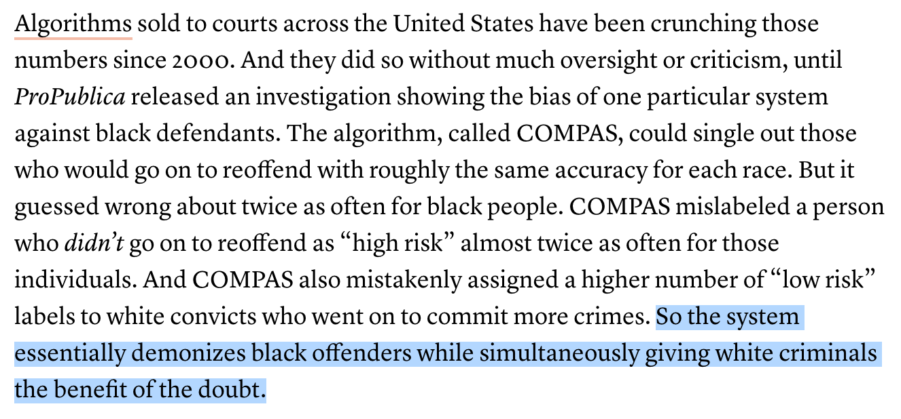
Notes:
https://qz.com/1427621/companies-are-on-the-hook-if-their-hiring-algorithms-are-biased/
https://www.popsci.com/recidivism-algorithm-random-bias

Slide 41
FIGHT THE ALGORITHMS
Incognito / private windows
adssettings.google.com

Slide 42
AVOID BIAS
Make sure your sample is representative
Think about theory
Remember that no data, models, or algorithms are neutral

Slide 43
CURIOSITY

Slide 44
How do I keep learning R?
What class should I take next?
What book should I read next?

Slide 45
You don’t learn R
You learn how to do things in R

Slide 46
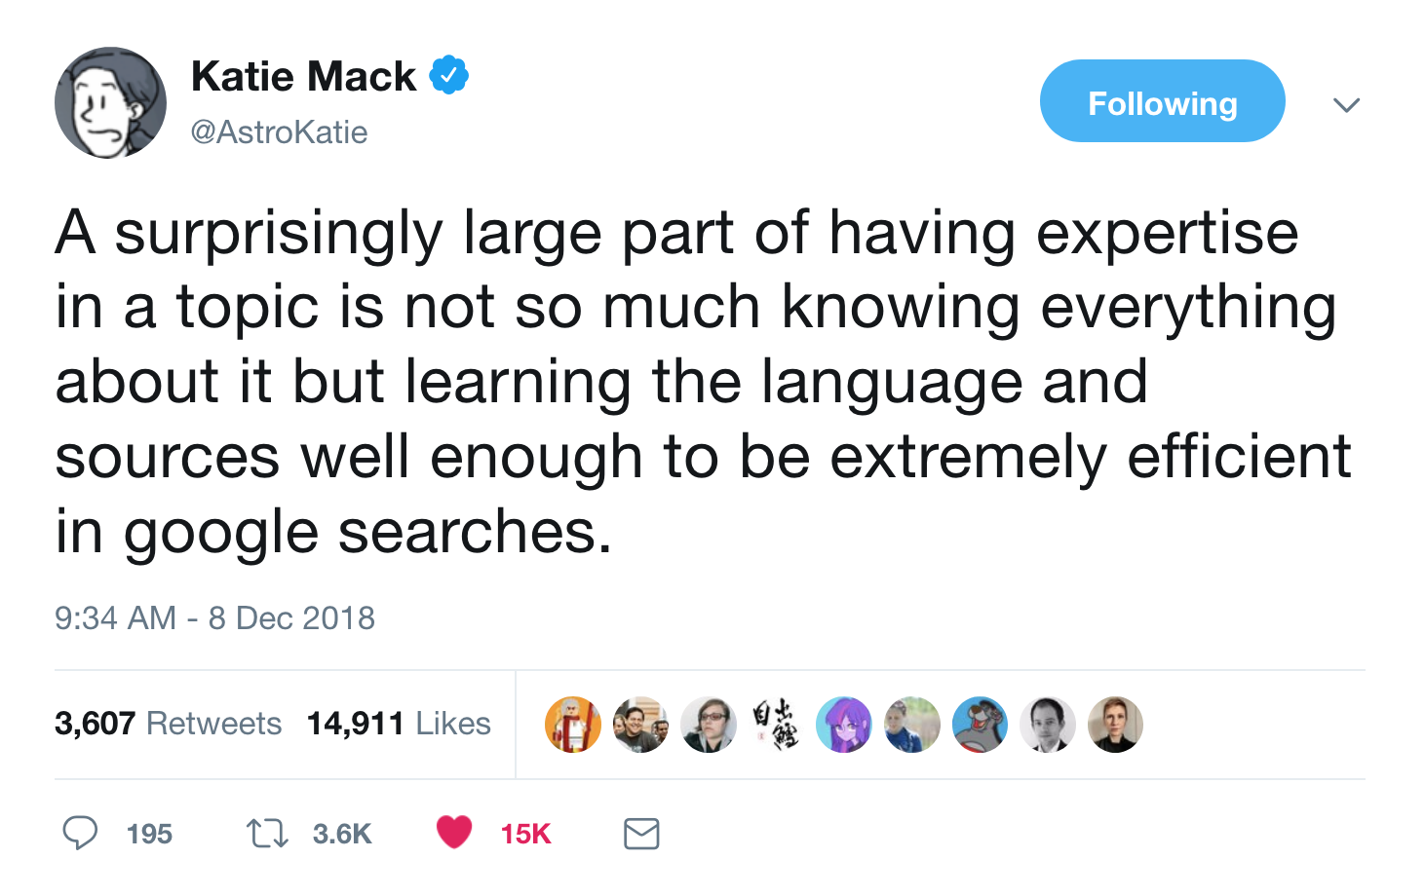

Slide 47
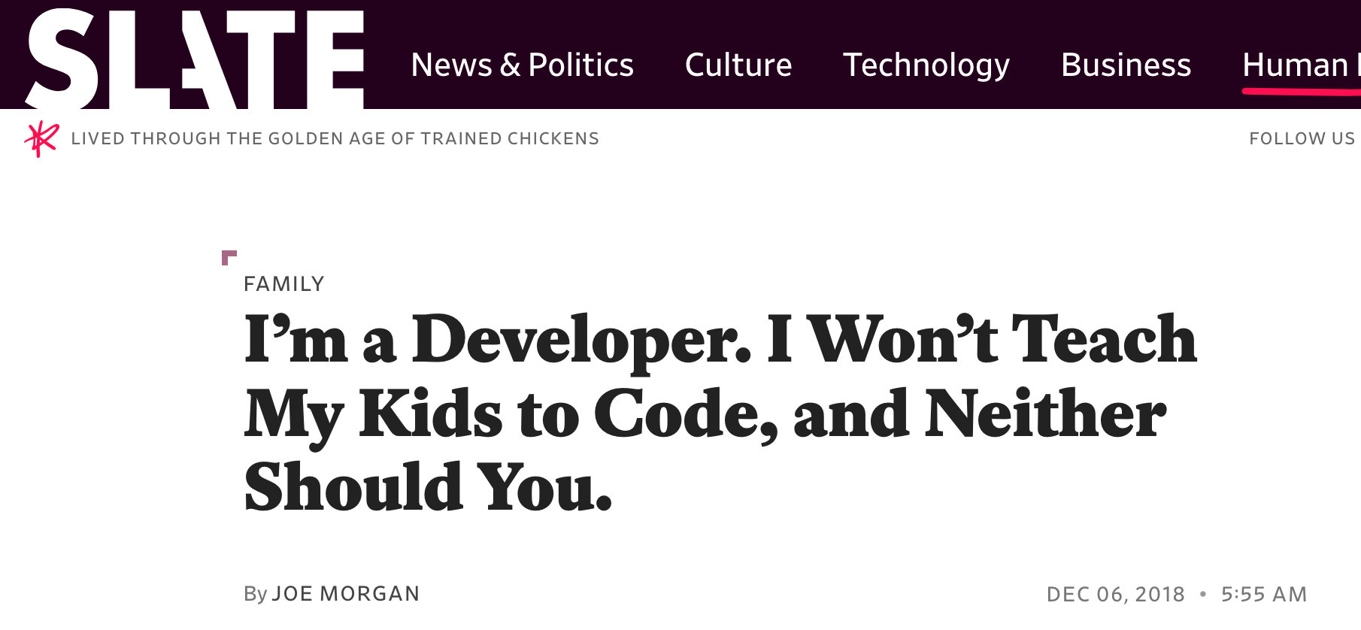
Notes:
https://slate.com/human-interest/2018/12/against-teaching-kids-to-code-creativity-problem-solving.html

Slide 48
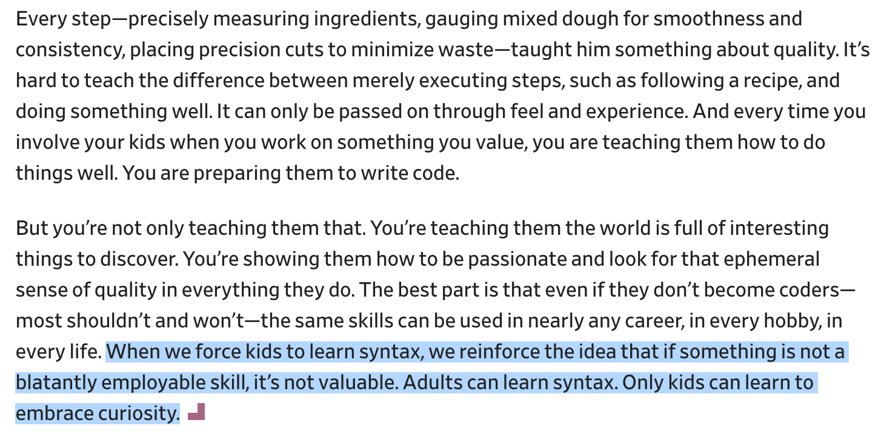
Notes:
https://slate.com/human-interest/2018/12/against-teaching-kids-to-code-creativity-problem-solving.html

Slide 49
EMBRACE CURIOSITY
Find excuses to use R
(This is why I subjected you to the code-through assignment)
Dumb dinky projects
Data play time
Actual projects

Slide 51
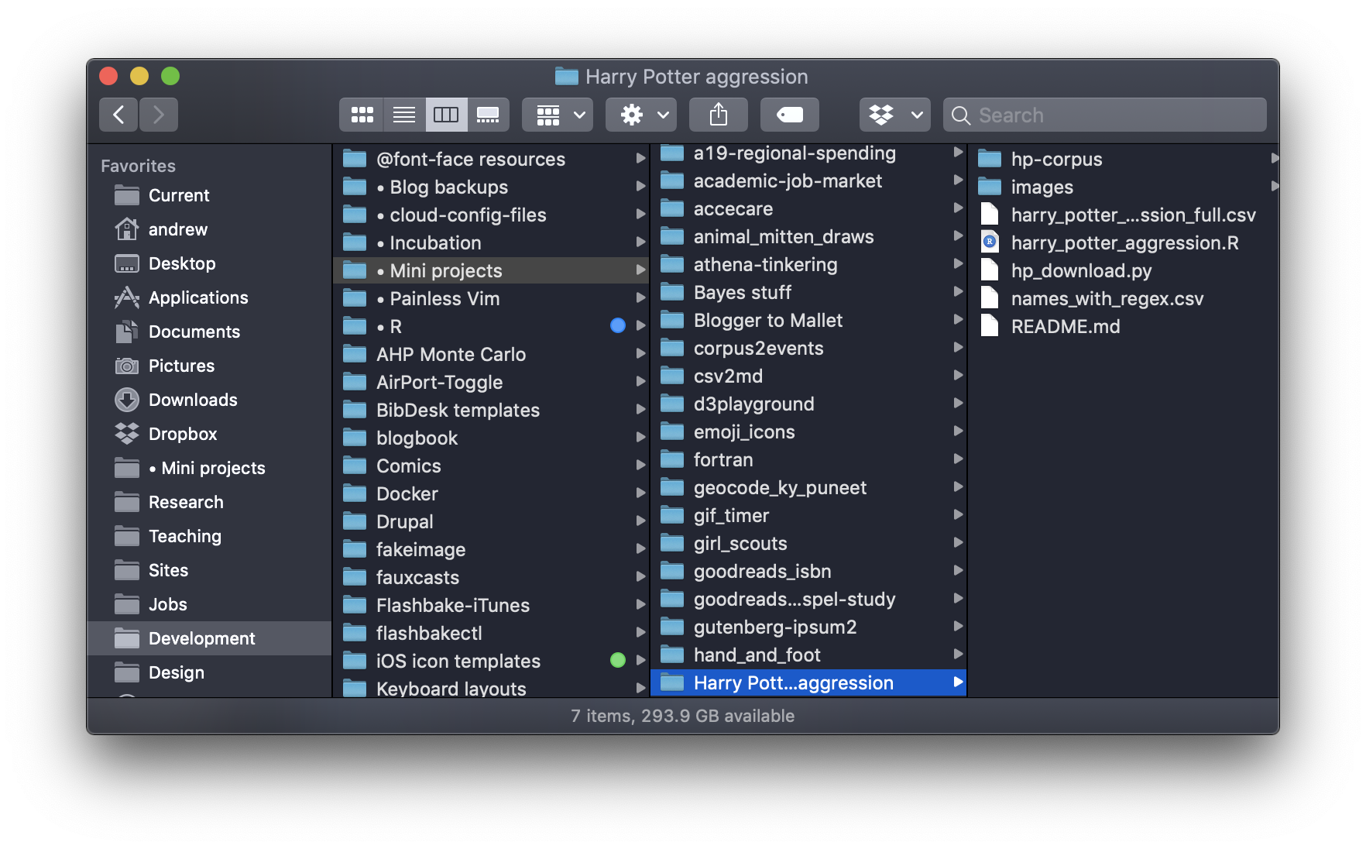

Slide 52
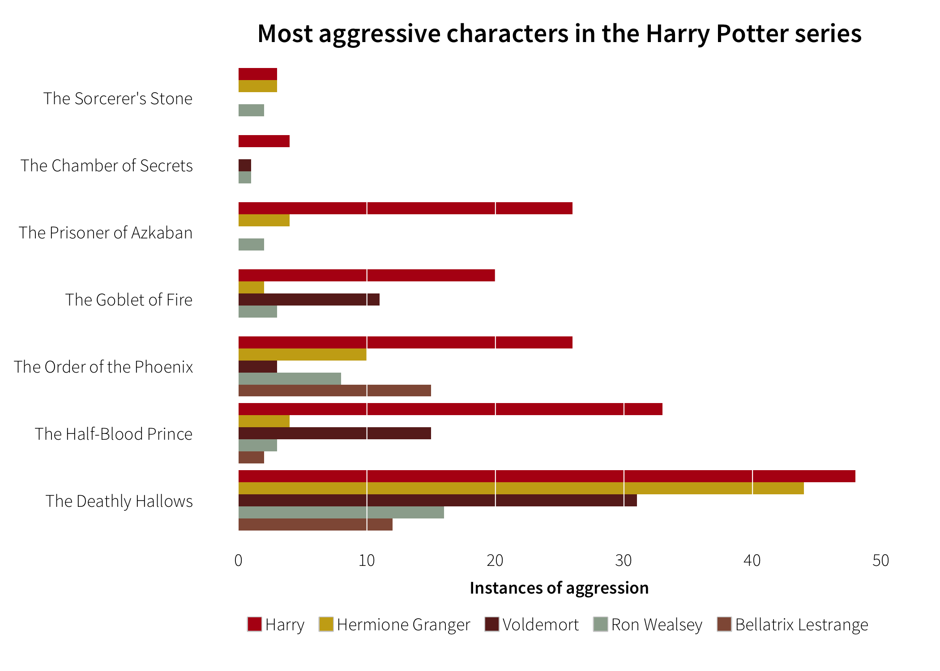

Slide 53
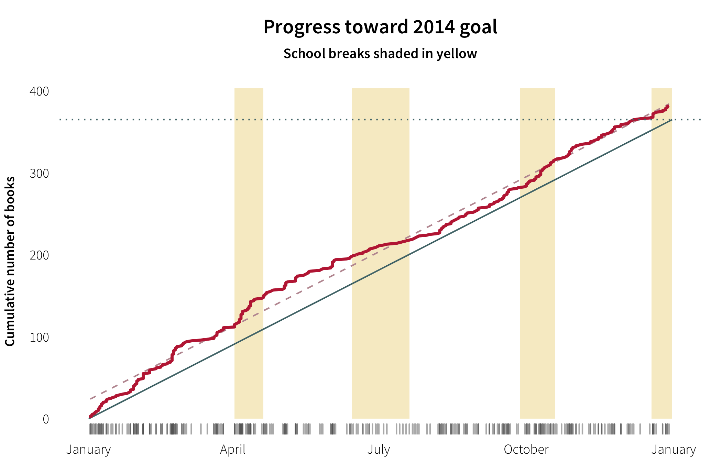

Slide 54
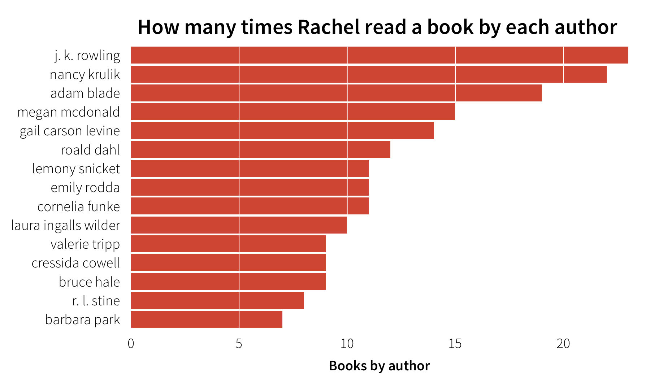

Slide 55
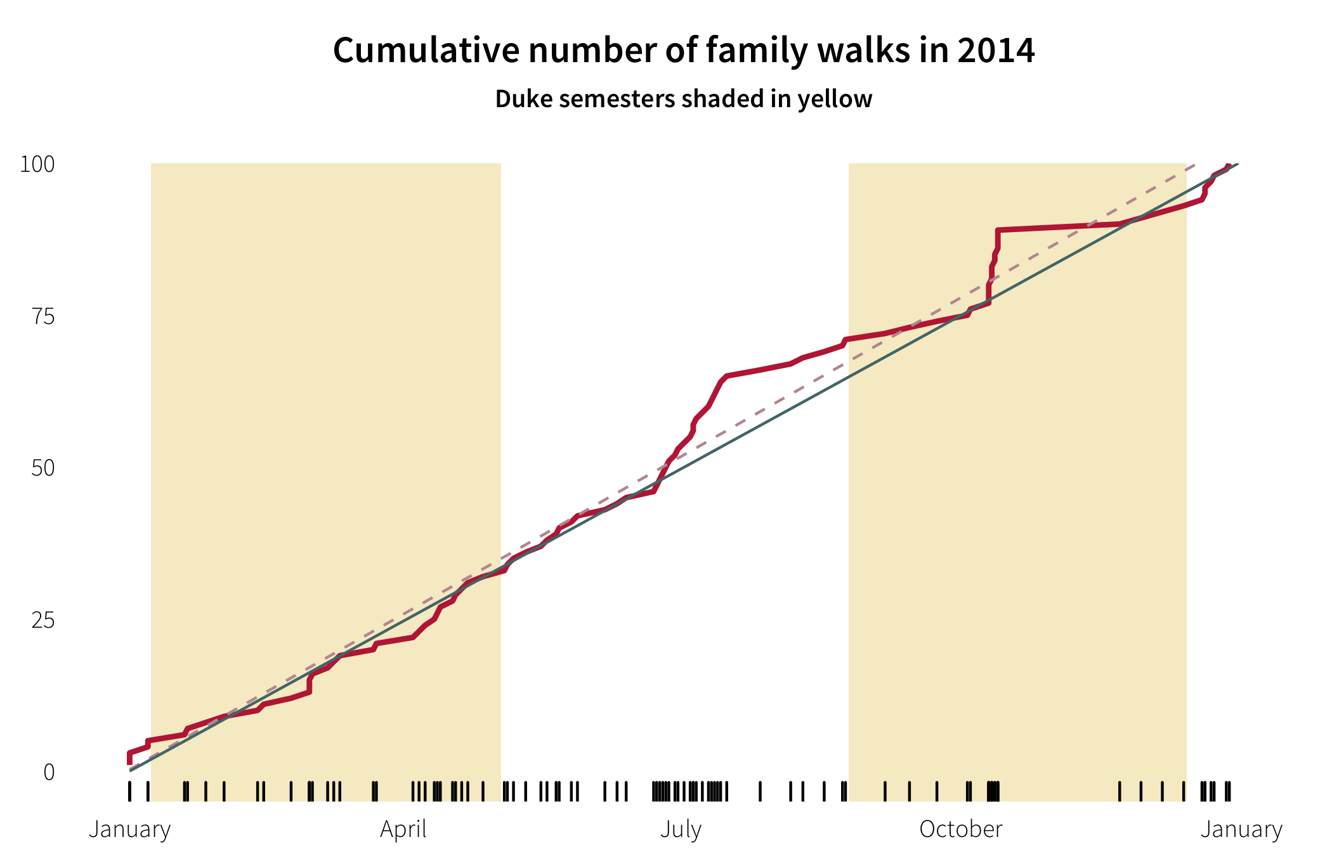
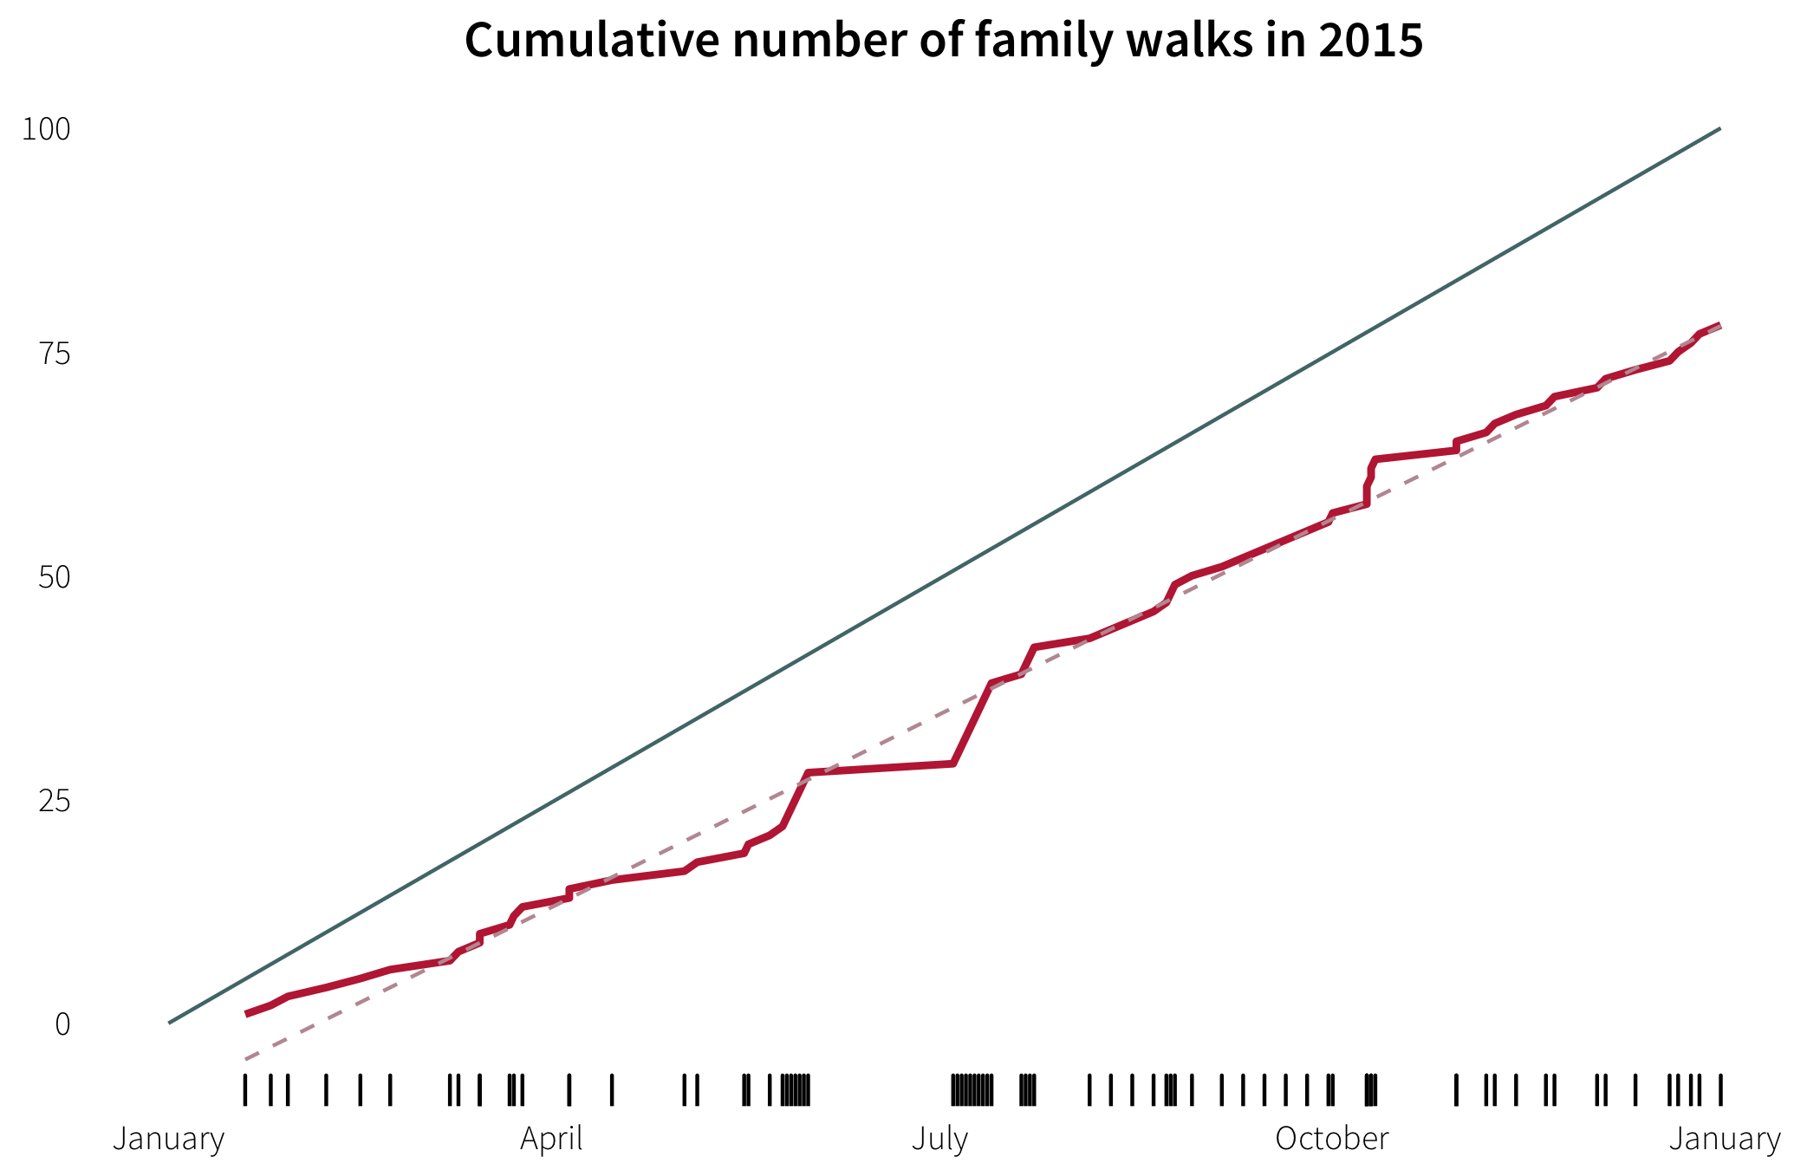

Slide 56
GET OUT IN PUBLIC
Share everything GitHub + Twitter + websites
#rstats
R User Groups SLC RUG
#rladies
Notes:
https://alison.rbind.io/post/up-and-running-with-blogdown/

Slide 57
You are all expert enough now.
Go make stuff!

